Slide 1

Adventure Tourism Analysis
Source: Departure Survey
Date – up until 2023
Neesha Pillay: Head Insights
neesha@southafrica.net

Slide 2
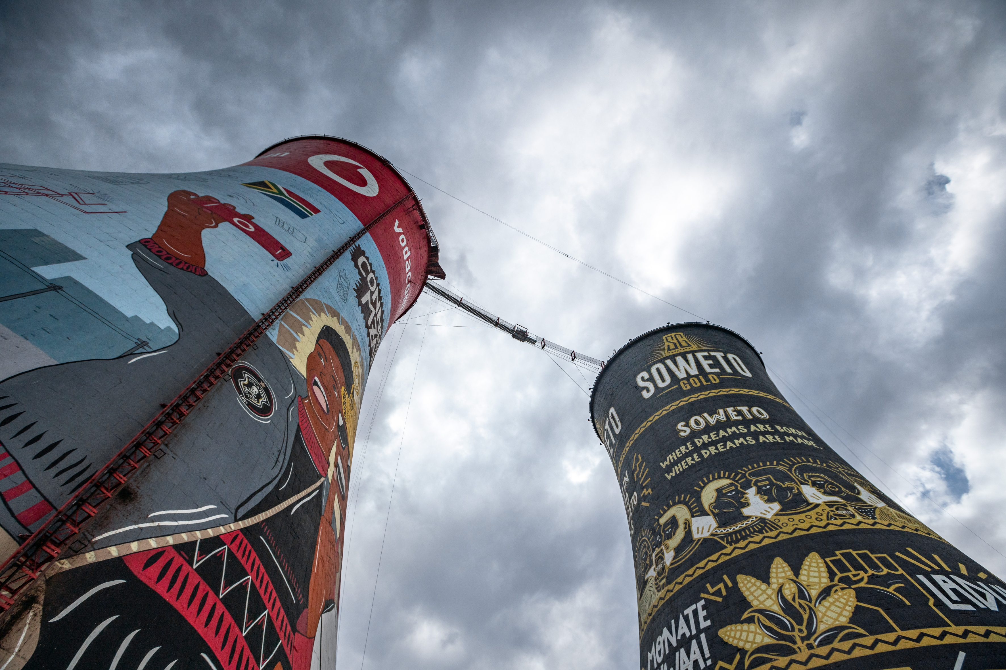
Incidence of Adventure Travel
The incidence in the adventure tourism market refers to the percentage of the market actively participating in adventure tourism activities. The top markets with regard to incidence is Norway, Switzerland, France, Sweden and Germany.

Slide 3
Adventure Tourism in terms of numbers
In terms of sheer numbers, most adventure tourists come from Europe, distantly followed by North America. The UK, Germany, and the USA bring in most of the adventure tourists to South Africa.
3

Slide 4
Key descriptors of Adventure Tourism Arrivals
The majority of adventure travellers are under the age of 40, with first-time travellers constituting the largest segment within this demographic. Additionally, there is a notable male skew among adventure travellers.
4

Slide 5
Reason for visting SA, and the best experience
In 2023, the primary motivation for tourists who incorporate adventure into their trips is to experience South Africa's natural scenery, diverse attractions, safaris, and South Africas perceived uniqueness.
5

Slide 6
Seasonality
The majority of adventure travellers tend to visit South Africa during the latter part of the year, with peak travel occurring in the final three months

Slide 7
Booking of accommodation and air ticket
These travellers easily book airline tickets directly with the airline via the internet or through online travel agents or travel aggregators. Accommodations are typically arranged through online travel agents, and there has been a decline in the preference for booking directly with the accommodation provider compared to 2019.

Slide 8
Purpose of visit and package type
Holiday is the primary purpose of visit for travellers engaging in adventure activities, with the majority preferring to book independently. Following this, travellers are inclined to opt for fully inclusive packages.

Slide 9
Bednights by province
The Western Cape is by far the most visited province with the most bednights spent in the province.
9

Slide 10
Attractions and Activities
The majority of the top attractions visited are located in the Western Cape, aligning with the high percentage of travellers who visit this province. Besides adventure activities, popular activities include beach outings, shopping, exploring natural attractions, and wildlife encounters.

Slide 11
Summary and Key insights
Market Incidence: Norway, Switzerland, France, Sweden, and Germany are the top markets in terms of the percentage actively participating in adventure tourism activities.
Geographical Origin: Most adventure tourists hail from Europe, with a lesser but still significant contribution from North America. The UK, Germany, and the USA are the primary sources of adventure tourists to South Africa.
Demographics: Most adventure travellers are under 40 years old, with a significant portion being first-time travellers. Additionally, there is a notable male skew among adventure travellers.
Motivations: In 2023, adventure travellers are primarily motivated by experiencing South Africa's natural scenery, diverse attractions, safaris, and the country's unique offerings.
Seasonality: Adventure travellers visit South Africa predominantly in the latter part of the year, with peak travel occurring in the final three months.
Booking Behavior: Adventure travellers prefer booking airline tickets directly with airlines or through online travel agents. Accommodations are typically arranged via online travel agents, showing a decline in direct bookings compared to 2019.
Travel Purpose: Holiday is the main purpose of visit for adventure travellers, with most preferring independent bookings, followed by fully inclusive packages.
Destination Preference: The Western Cape stands out as the most visited province, with the highest number of bednights spent there. Additionally, the majority of top attractions visited are located in the Western Cape, reflecting the preferences of adventure travellers. Popular activities include adventure sports, beach outings, shopping, exploring natural attractions, and wildlife encounters.

